Slide 1
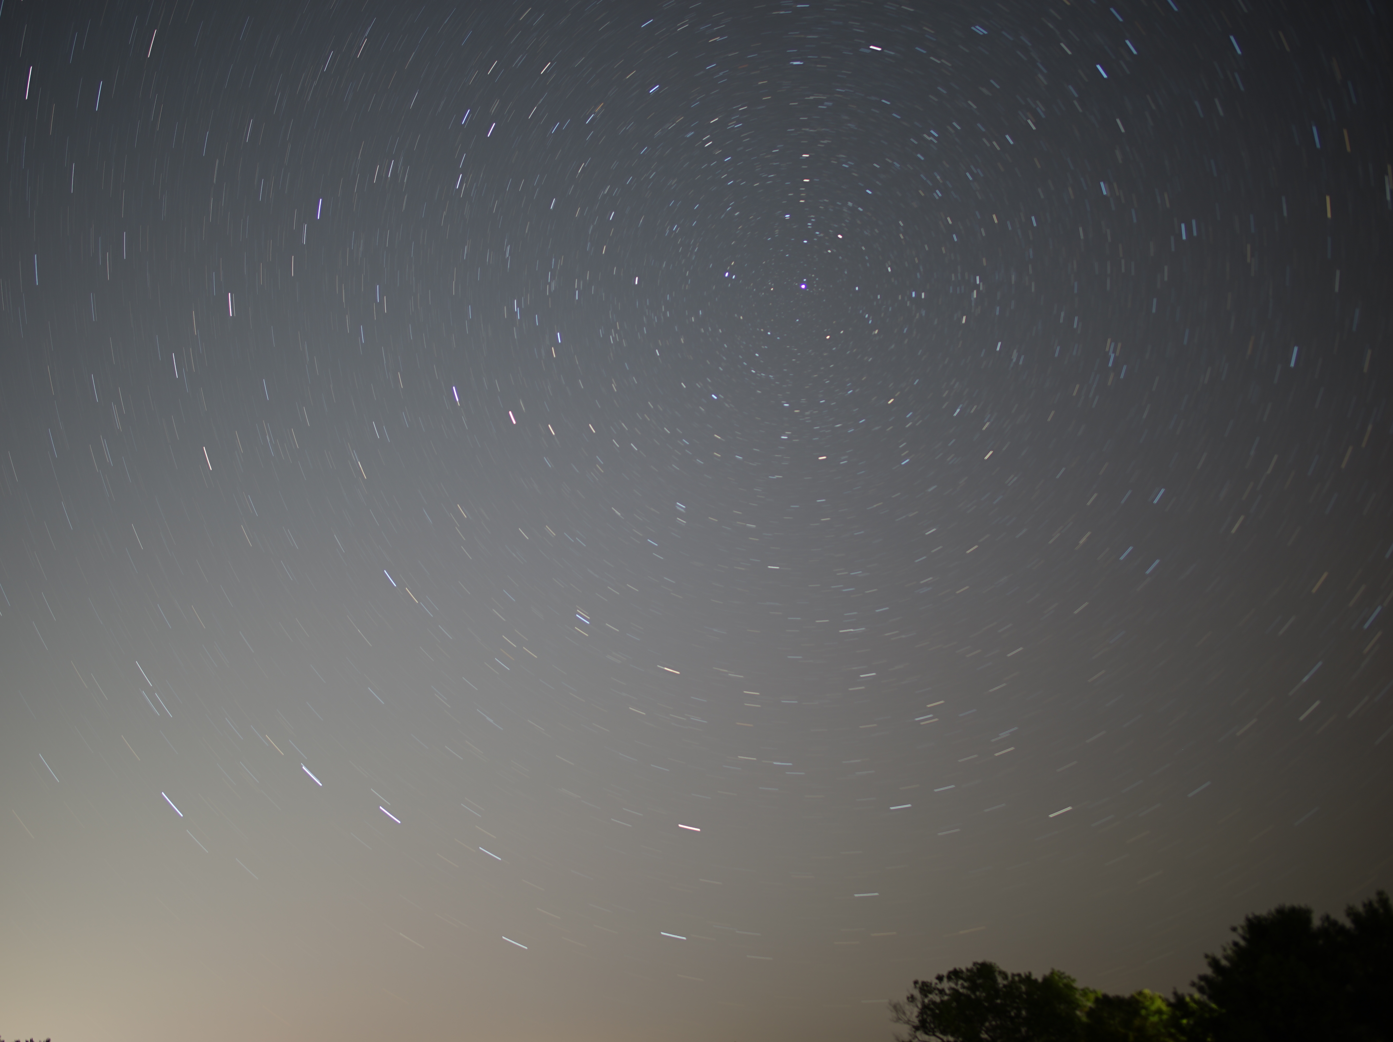
Astronomy 100/101 Lab 3
Wednesday 10 Mar / 17 Mar 2021 12.20 pm
Yvonne Ban: yiwenban@astro.umass.edu
Zhiyuan Ji: zhiyuanji@astro.umass.edu
Yvonne Ban
12 Sept 2020
Exp time: 9m 08s

Slide 2
Follow-ups
Lab 2 picture deadline has been moved to 20 Mar.
Grades for Lab 0 and Lab 1 will be posted soon – watch for an email from us.
Try to contact us for extensions as early as possible. We’re flexible, but leaving it to the last minute leaves you at the mercy of when I check my emails.

Slide 3
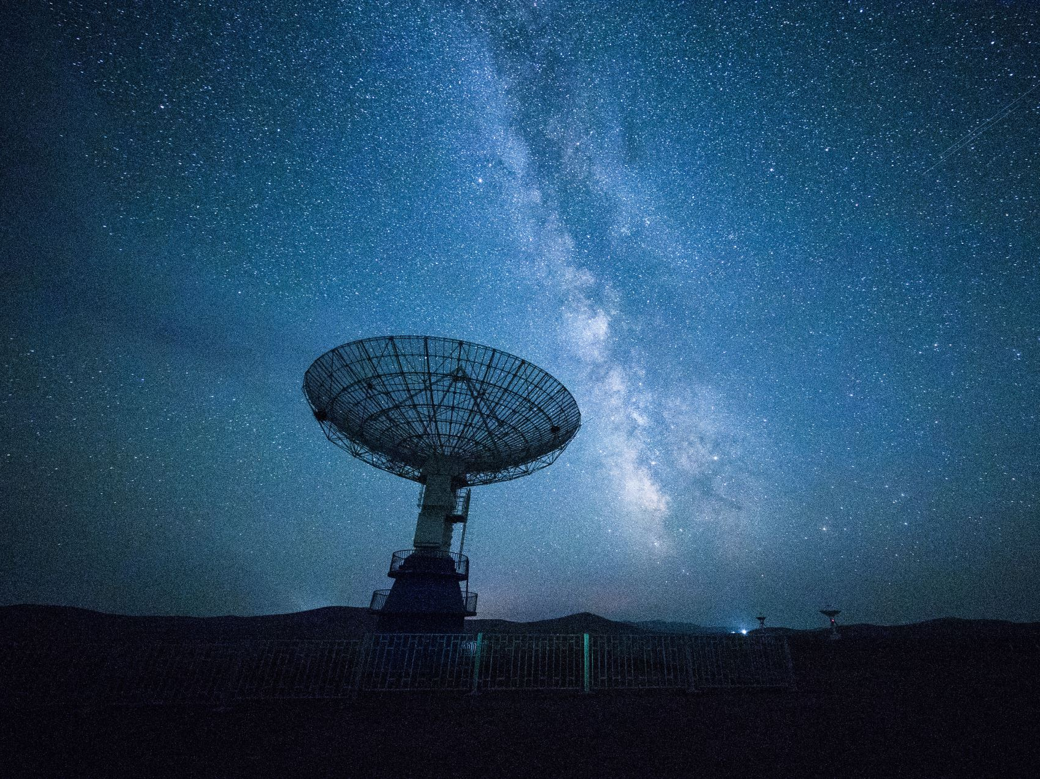
The Zodiac – a ‘zoo’ of stars

Slide 4
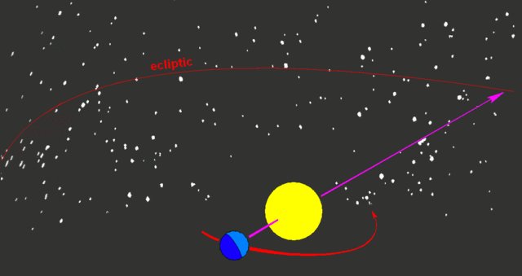
What is the Zodiac?
As the Earth orbits the Sun, the background stars change throughout the year.

Slide 5
The Sun, the Moon, & the Zodiac
Open Stellarium and set it to your home location.
You can also stop time (the pause button in the bottom panel) and set the time to noon.
Make the constellations visible.
Turn off the Atmosphere visualisation.
Open the Sky and Viewing options window.
Go to the Starlore tab.
Under Options, check Show labels and Show boundaries.

Slide 6
The Sun, the Moon, & the Zodiac
Find out what constellation the
Sun
Moon
are in today.
Click on the Sun and hit the spacebar. This will centre and lock on the Sun.
Move forward in time by jumping by day.
Find out the constellations that the Sun moves through over a year.

Slide 7
What’s your sign? (a.k.a. the only astrology we’re doing in this class)
Shift Stellarium to your birth date.
What constellation was the Sun in?
Save a screenshot of the Sun’s location.
Look at the table. What is your sign?
From Stellarium, when is the Sun actually in your horoscope sign?
Aries | Mar 21 – Apr 19 | Libra | Sep 23 – Oct 22
Taurus | Apr 20 – May 20 | Scorpio | Oct 23 – Nov 21
Gemini | May 21 – Jun 20 | Sagittarius | Nov 22 – Dec 21
Cancer | Jun 21 – Jul 22 | Capricorn | Dec 22 – Jan 19
Leo | Jul 23 – Aug 22 | Aquarius | Jan 20 – Feb 18
Virgo | Aug 23 – Sep 22 | Pisces | Feb 19 – Mar 20

Slide 8

What’s your sign? (a.k.a. the only astrology we’re doing in this class)
How far has the zodiac drifted?
Set Stellarium to a date in the middle of your horoscope sign.
Jump back in time in 500-year blocks until the Sun is actually in the middle of your horoscope sign. How far did you have to go?

Slide 9
What’s your sign? (a.k.a. the only astrology we’re doing in this class)
The stars do move!
Jump back to today and turn on the equatorial (NOT azimuthal!) grid.
Look at the North celestial pole.
Which star is nearest to it?
Which star was nearest to it when horoscopes were aligned with the zodiacal constellations?
Find Vega in the sky.
Jump back in time in 1000-year blocks. When was Vega the North star?
Jump forward in time in 1000-year blocks. When will Vega be the North star?

Slide 10
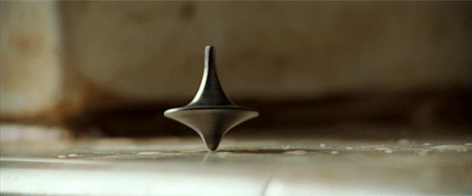
Why do the stars move? Precession of the Earth’s axis
The Earth is rotating 1x per day, but it’s also wobbling or precessing
This motion is much slower – one cycle every 26,000 years.

Slide 11
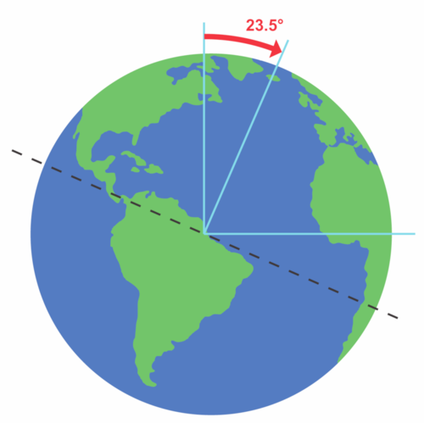
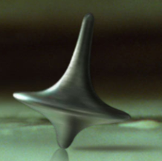
Why do the stars move? Precession of the Earth’s axis

Slide 12
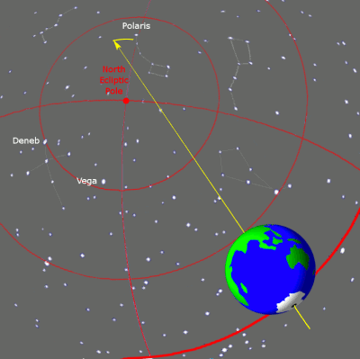
Why do the stars move? Precession of the Earth’s axis
Because of precession, the North Star is not constant.
It won’t always be Polaris…

Slide 13
Why do the stars move? Precession of the Earth’s axis
A full cycle of precession takes 26,000 years…
There are 13 (not 12!) constellations in the Zodiac…
So the Sun moves to a new constellation for a given date every 26,000/13 = 2000 years.
Roughly how old is Western astrology? 2000 years.

Slide 14

Other zodiacs
What’s your horoscope sign in another zodiac?
Go back to your birth date.
Pick the constellations from another culture.
Go to Sky and viewing options and go to the Starlore tab.
Choose another cultural constellation system (other than Western).
Which constellation is the Sun in?
If no labelled constellation is available, do some research online and tell us about what you find.

Slide 15
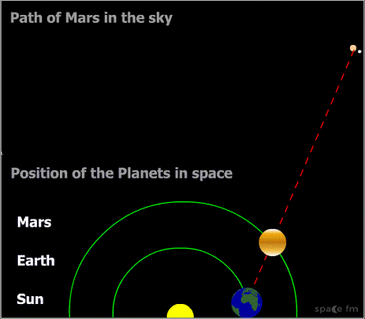
What is retrograde motion?
As the Earth “passes” other planets in their orbits, they appear to move backwards for a brief time...
Much like when you pass another car on the highway.

Slide 16
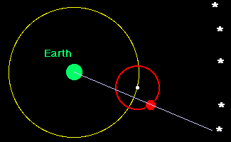
Retrograde motion was a major problem for ancient astronomers…
Until a few centuries ago, when astronomers thought the Earth was the center of the solar system, they had to use epicycles to explain retrograde motion.

Slide 17
Mars-ching to the beat of its own drum
Centre your view on Pisces.
Set Stellarium to 1 June 2020.
Turn off the atmosphere and ground visualisations.
Switch to the equatorial axis. (This is NOT the same as turning on the equatorial grid!)
In Sky and viewing options, turn on constellation lines and labels as before.
Centre and zoom in on Pisces.
Find Mars on the sky.
Plot the position of Mars every month for one year (i.e. once a month from June 2020 to June 2021).
Connect the points. How many days was it moving backwards (retrograde)?

Slide 18
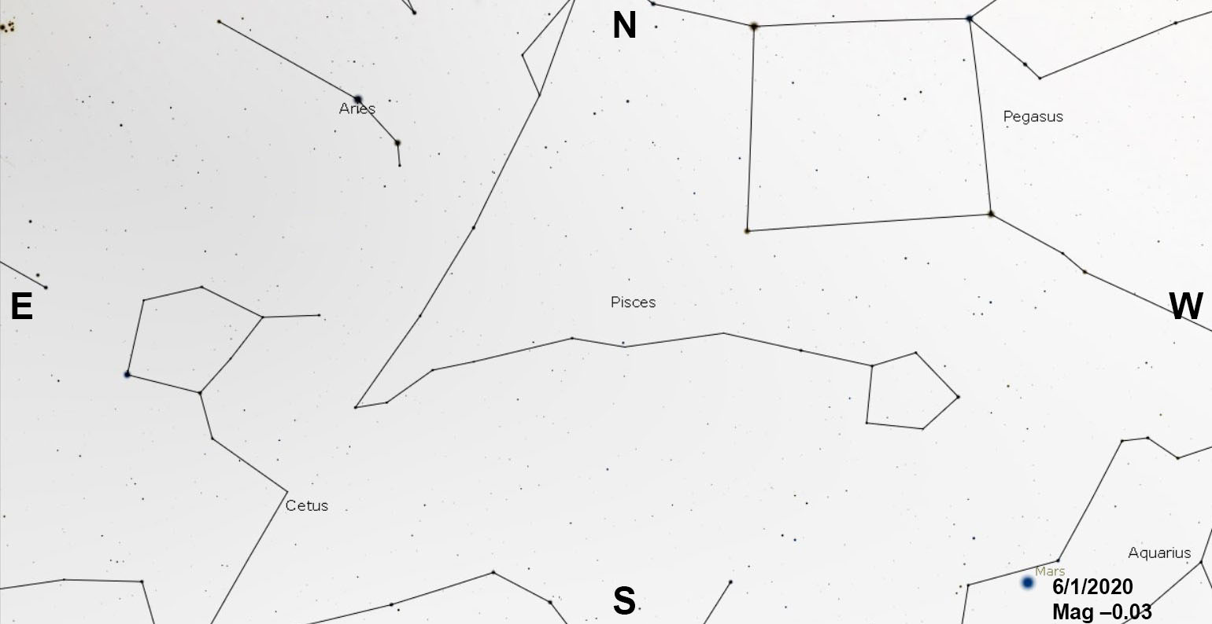

Slide 19

Mars-ching to the beat of its own drum
Go back through the same period. This time, zoom in on Mars and take note of its magnitude, phase, and size.
Note the highest and lowest magnitudes and note them on the chart.
Repeat for all the planets. Do they all go retrograde (i.e. move backwards for some time)?

Slide 20
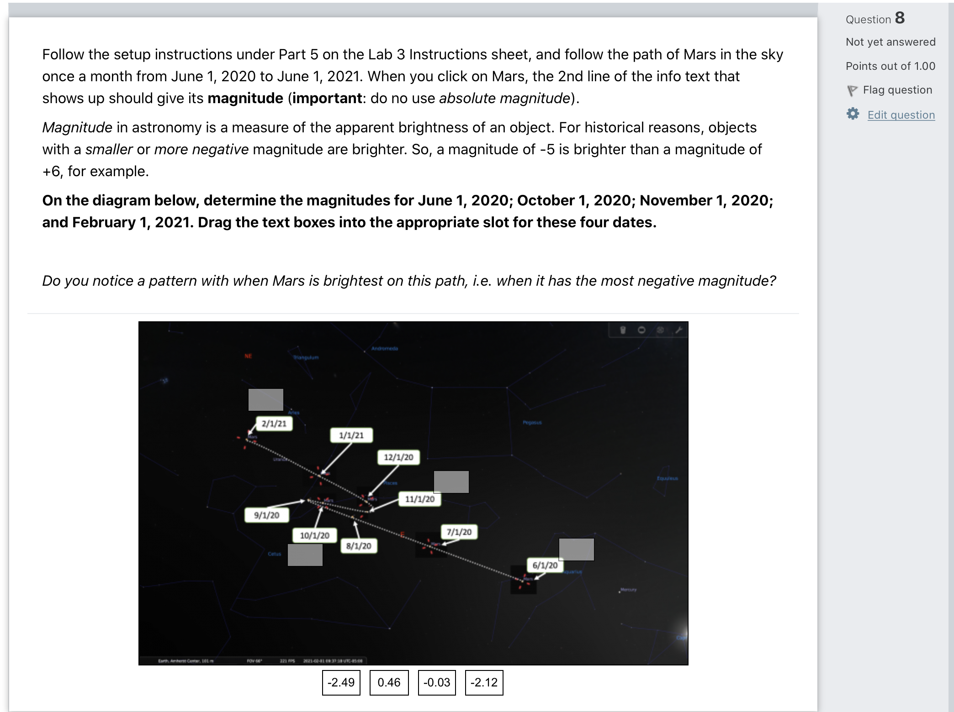

Slide 21
Assignment Summary
By Wednesday 24 March 2021 23:59 EDT:
Fill out Lab 3 Questions on Moodle
Submit a screenshot of Stellarium showing which constellation the Sun is located in on your birth date
Note for students in other time zones: Massachusetts starts Daylight Savings on 16 March. That means that we will be moving 1 hour earlier.

Slide 22
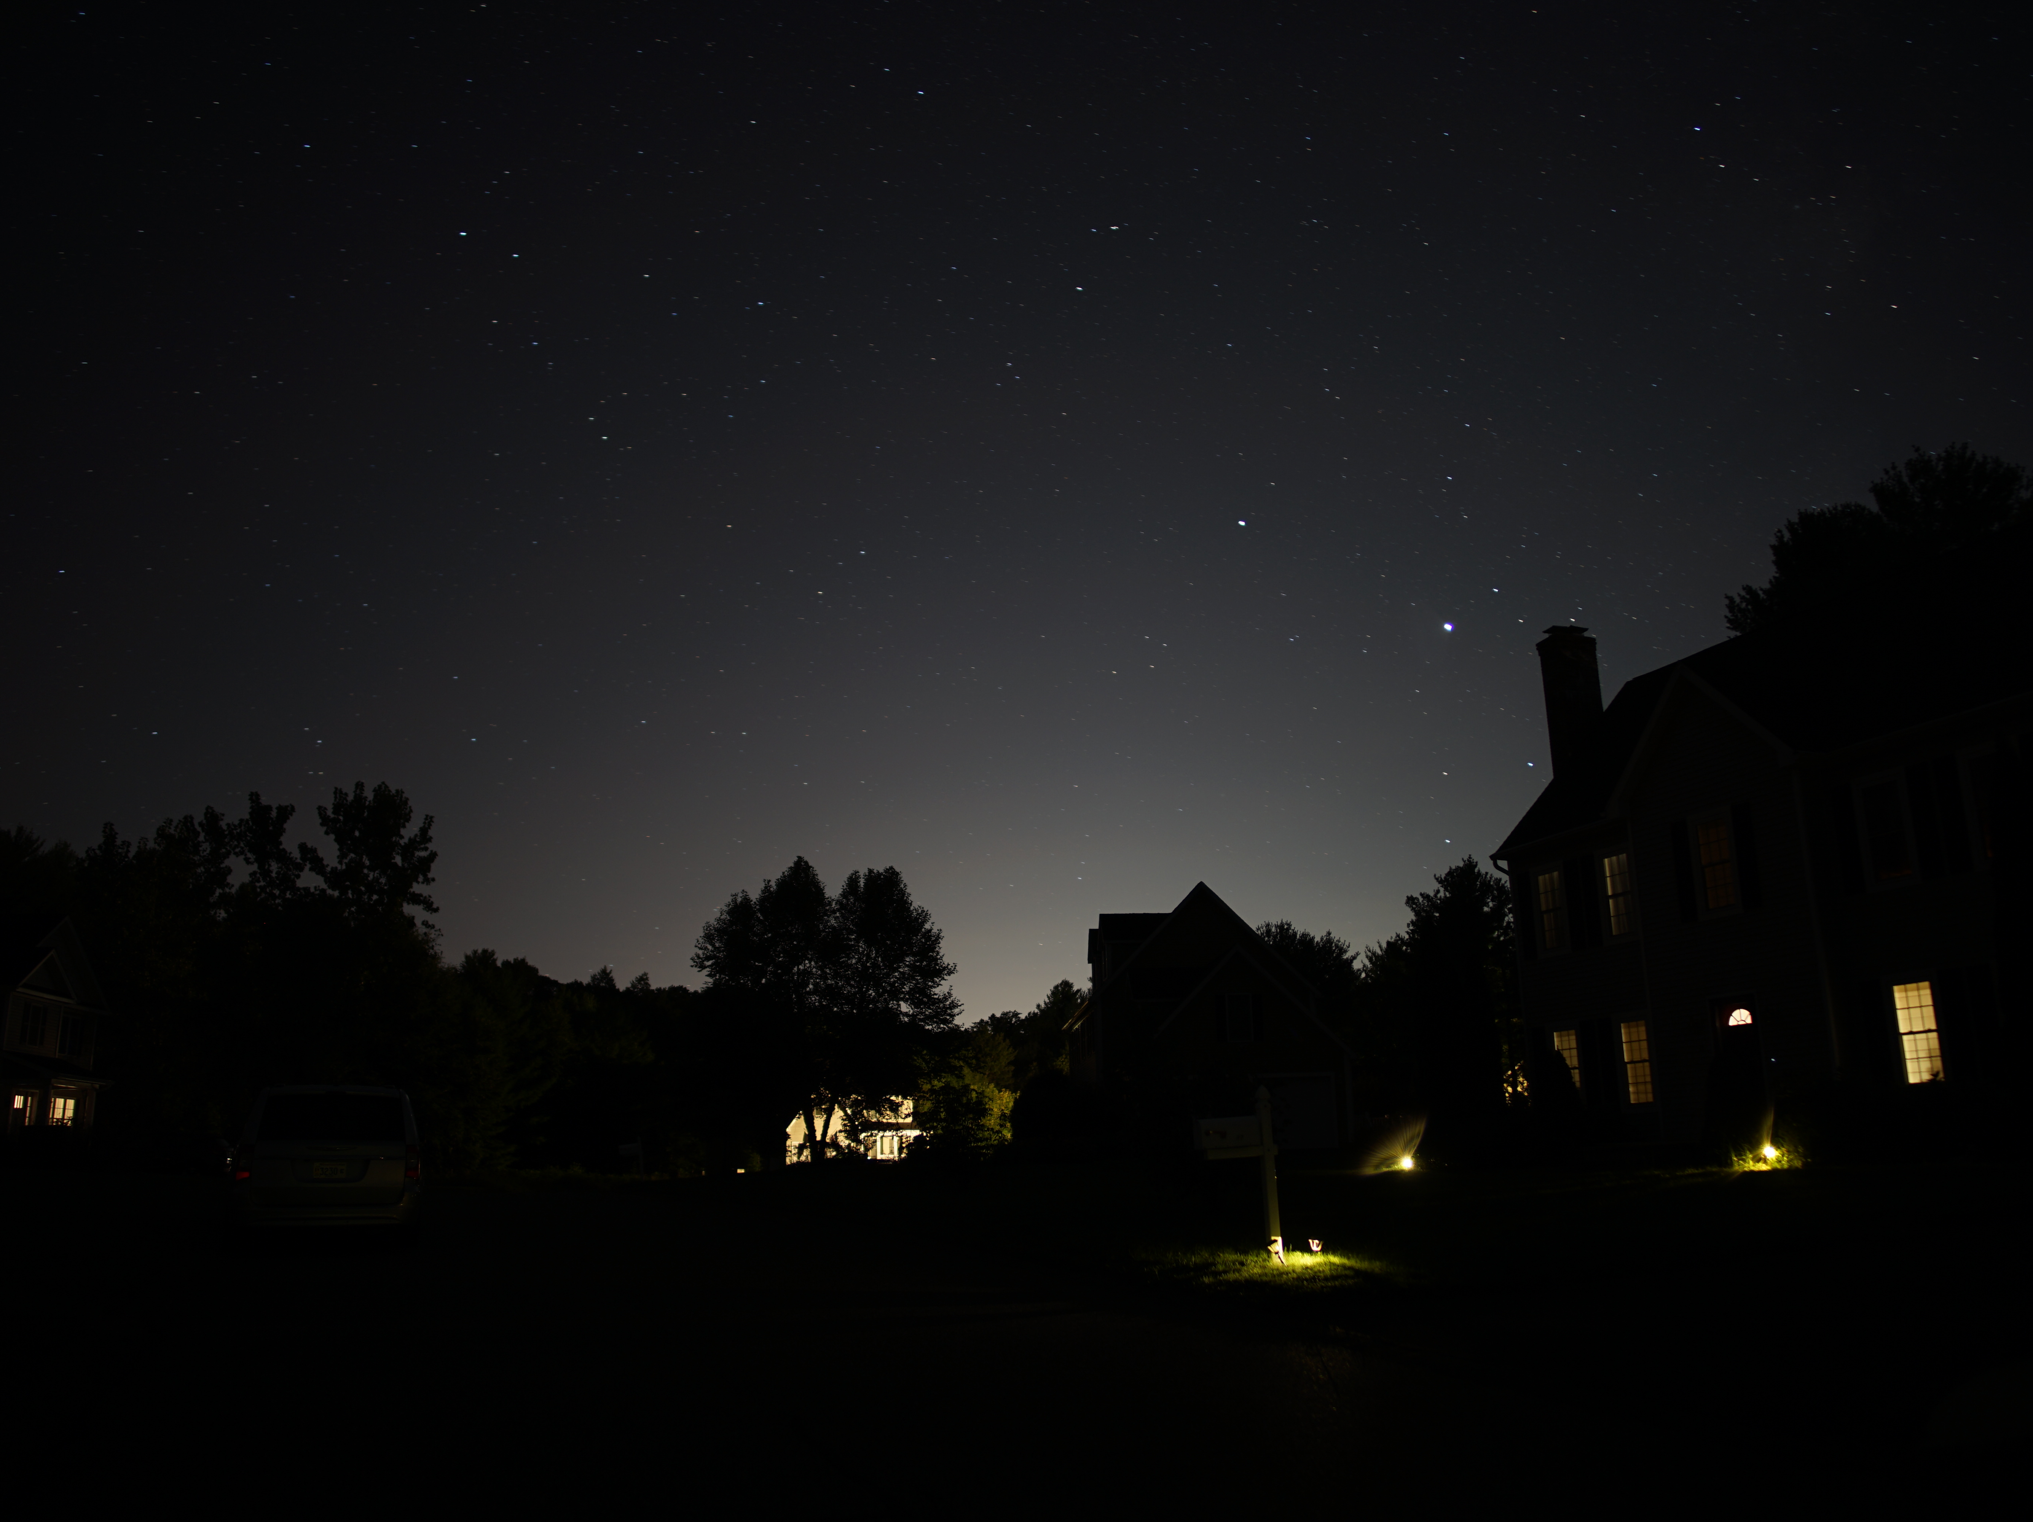
Yvonne Ban
12 Sept 2020
Exp time: 30s

